Slide 1

Detecting Hate Speech in Kenyan Political Tweets
A Natural Language Processing Approach

Slide 2
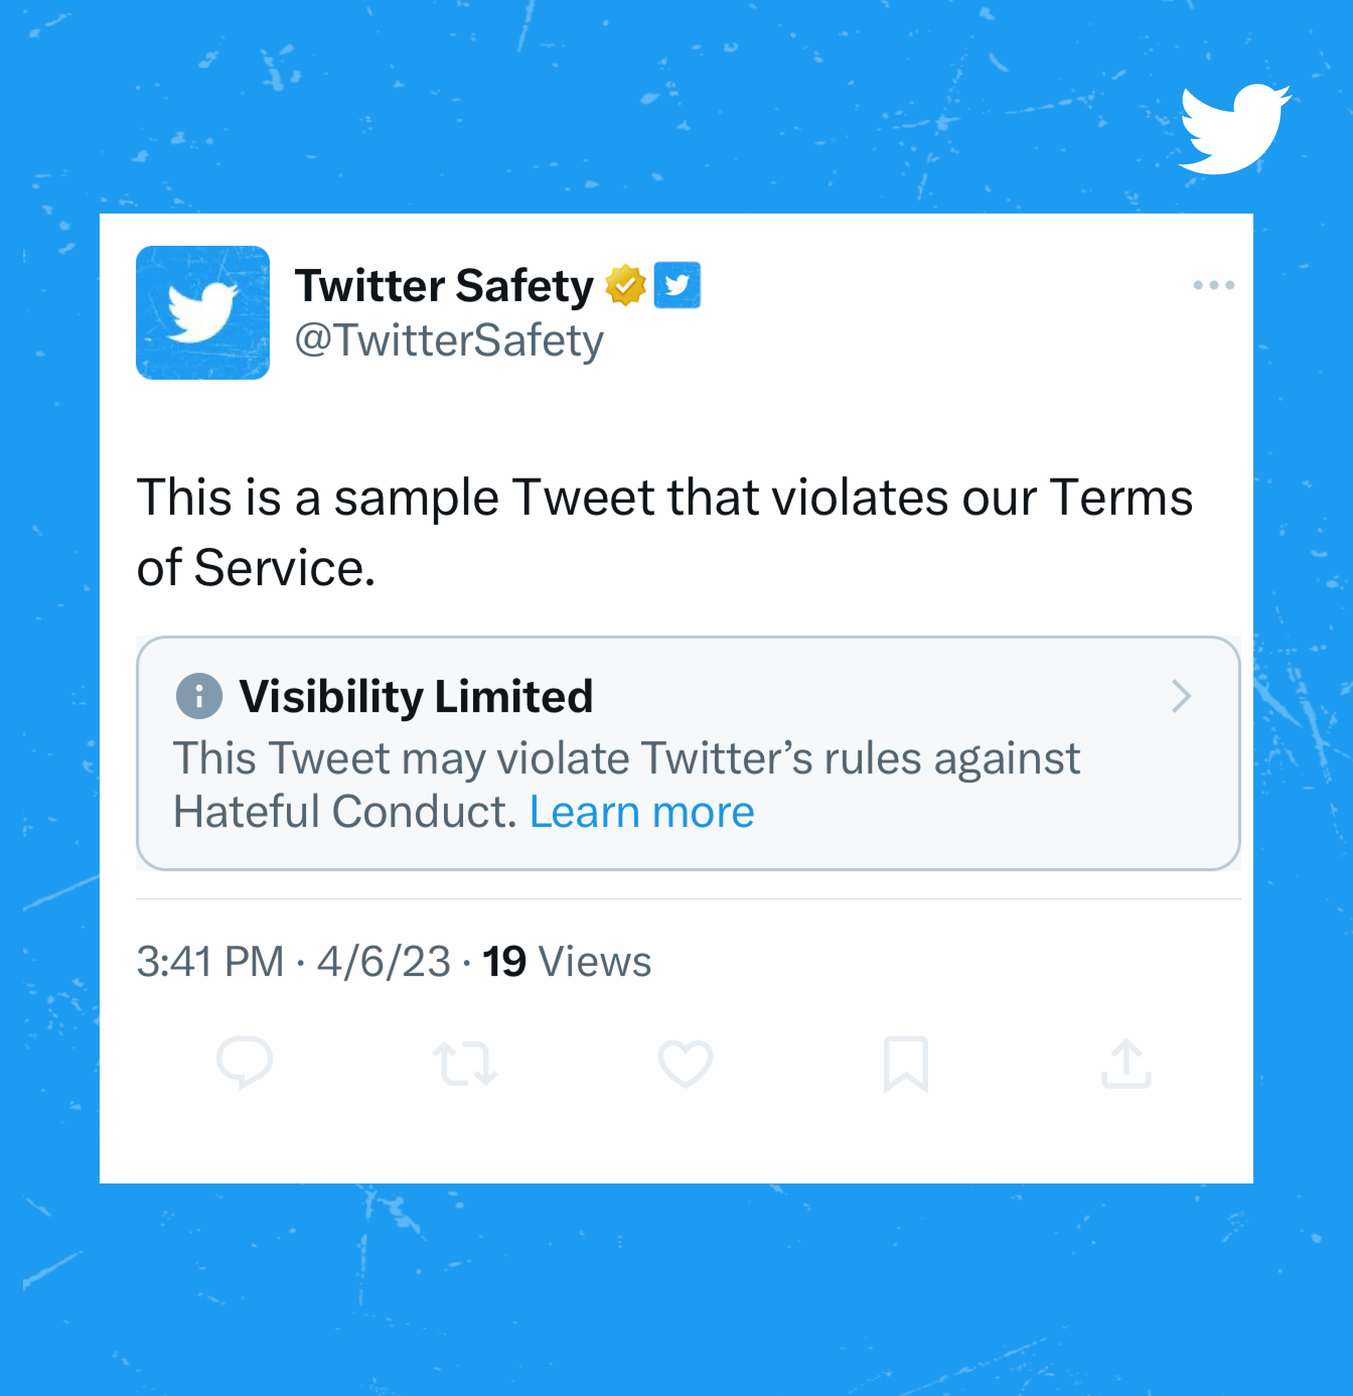
Imagine a Twitter-like platform where users can post freely. A place where hate speech posts can be automatically flagged or hidden within seconds—drastically improving the experience for users and reducing platform liability.
INTRODUCTION
In today's digital age, political discourse has increasingly shifted online.​ However, with this shift comes a rise in harmful content — hate speech.

Slide 3

MEMBERS
1. Kenneth Nyangweso
2. Bernice Kutwa
3. Amani Amkaya
4.Sumaiya Abdullahi
5. Vincent Mutuku

Slide 4
Why detect hate speech ?
Hate speech can incite violence and deepen divisions.
Early detection allows for better moderation and societal interventions.
In Kenya's multilingual landscape, detection is more complex — and more crucial.

Slide 5
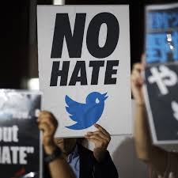
Goal
To build a model that detects hate speech from tweets mentioning or targeting Kenyan politician

Slide 6
Objective
Identify hate speech within tweets mentioning Kenyan politicians.
Analyze linguistic patterns across English, Swahili, and Sheng.
Build machine learning model to automate detection.

Slide 7
success Metrics
Macro F1-Score ≥ 65%, with improved recall for the hate class.
Demonstrate ability to handle imbalanced data effectively.
Show improved detection of multilingual and nuanced hate speech compared to baseline models.
.

Slide 8
Business Impact
Enables real-time moderation of harmful political content.
Reduces platform liability for hosting hate speech.
Improves user trust and engagement by creating a safer online space.
Supports regulatory compliance in high-risk political environments.
.

Slide 9
Data Understanding
11,317 tweets collected using Tweepy and Twint.
Focused on tweets mentioning key Kenyan politicians.
Dataset has 6 features, including text and metadata.
Tweets labeled as Hate or Neutral.

Slide 10
Data Understanding
The data contains :
Tweet ID: Unique tweet identifier for traceability.
Likes: Number of likes — measures tweet popularity.
Retweets: Number of retweets — indicates content spread.
Total Replies: Direct user responses — reflects engagement/controversy.
Texts: Full tweet text — primary input for NLP tasks.
Created At: Timestamp — enables temporal analysis.

Slide 11
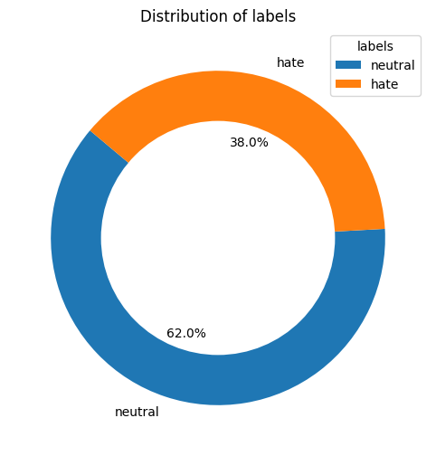
Class Distribution
Observations
The chart visually depicts a significant class imbalance in the dataset.
The "neutral" class has the highest percentage of 62.0%, and "hate" 38.0%

Slide 12
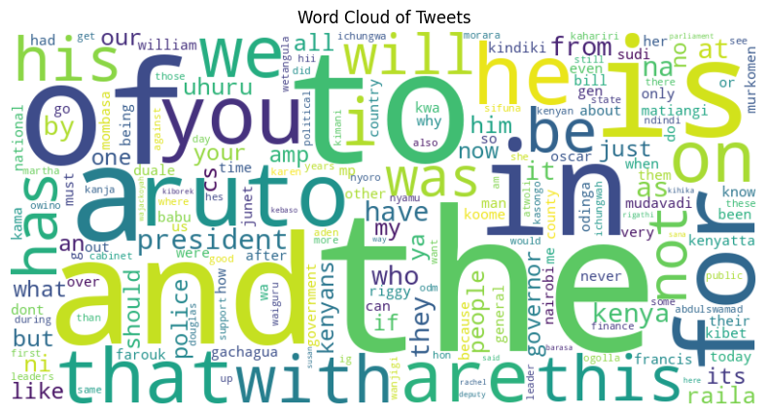
Word Cloud: Dominant Language in the Discourse
Observations
Most frequent words highlight political focus, including names like "ruto", "president", and "government".
Presence of emotionally charged terms suggests public dissatisfaction and protest-driven language.
Overall, the vocabulary reflects intense political discourse and social unrest.

Slide 13
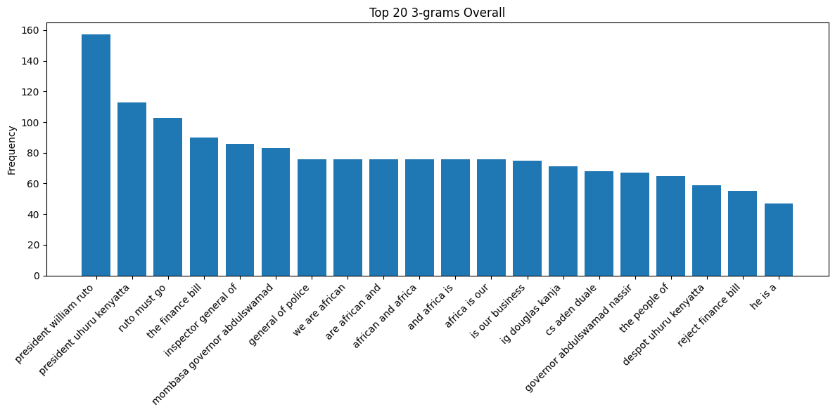
Frequent Phrase Patterns in Political Tweets
Observations
"President William Ruto", "Ruto must go", and "Reject finance bill" dominate — highlighting political protest.
Clusters like "CS Aden Duale" and "Finance bill" suggest focus on governance issues.
Identity phrases like "We are African" show elements of cultural expression.

Slide 14
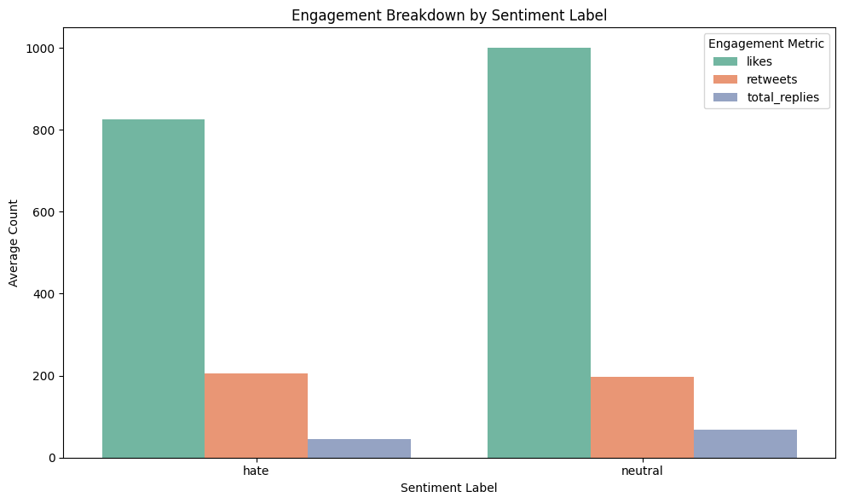
Distribution of tweet lengths by class
Key Insights
👍 Likes dominate all sentiment types
🟢 Neutral posts attract the most likes & replies
🔁 Retweets remain stable across sentiments
🚫 Hate posts show lowest engagement overall

Slide 15
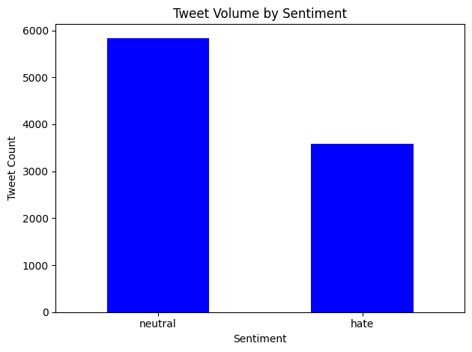
Distribution of tweet lengths by class
Key Insights
Neutral tweets dominate the dataset.
Hate tweets are the least common sentiment category.

Slide 16
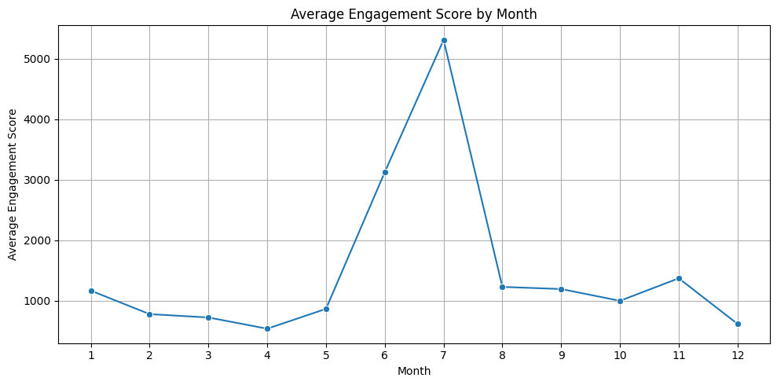
Distribution of Average Engagement by Month
Observations
July shows the highest engagement spike, indicating a major event or increased activity, while other months maintain relatively low and stable engagement.

Slide 17
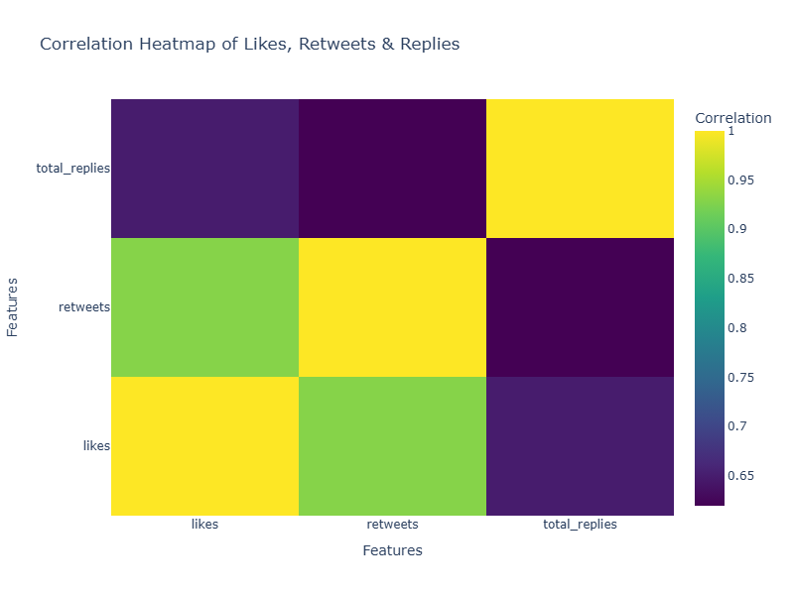
Engagement Correlations: Likes, Retweets & Replies
Observations
Likes & Retweets: Strong positive correlation (~0.95), indicating shared audience behavior.
Retweets & Replies: Moderate correlation (~0.76), suggesting retweets spread content but don’t always spark conversation.
Likes & Replies: Weakest correlation, meaning likes don’t strongly predict replies.

Slide 18

Data Cleaning & Preprocessing

Slide 19
Preparing Tweets for Analysis
Removed user mentions, URLs, hashtags, and special characters
Converted all text to lowercase
Tokenization: split text into individual words
Removed stopwords (e.g., "the", "is", "and")

Slide 20
Preparing Tweets for Analysis
Applied Lemmatization: reduced words to their root form
TF-IDF Vectorization used to transform clean text into numerical features
Observation:
Preprocessing significantly reduced noise and improved the quality of input for machine learning models.

Slide 21
Machine Learning Modeling

Slide 22
Text Classification Models
Features Used:
TF-IDF vectors from preprocessed tweets
Target Variable:
Two classes: Hate and Neutral

Slide 23
Models Used:
Modular Pipeline:
6 models: Naive Bayes, Logistic Regression, SVM, Random Forest, Gradient Boosting, Neural Network.
Imbalance Handling: SMOTE for synthetic minority class oversampling.
Hyperparameter Tuning: Grid search for optimizing macro F1 (focus on minority hate class).
Ensemble Strategy: Majority voting (Logistic Regression + SVM + Random Forest).

Slide 24
Model Performance Evaluation
Base Models:
Best: Gradient Boosting (F1 = 0.6441).
Weakness: Poor minority-class recall (misclassified hate instances).
Tuned Models:
Logistic Regression: Highest F1 (0.6583) but modest accuracy (65.48%).
Neural Network: Worst F1 (0.5988).
Gradient Boosting: F1 dropped post-tuning (0.6178).
Ensemble: F1 = 64.75% (underperformed vs. standalone Logistic Regression)

Slide 25
Model Evaluation
Metric | Description
Accuracy | Proportion of total correct predictions.
Precision | Out of predicted "hate", how many were correct.
Recall | Out of actual "hate", how many were detected.
F1 Score | Harmonic mean of Precision and Recall.

Slide 26
Evaluation Results
Model | Accuracy | Precision | Recall | F1 Score
Logistic Regression | 65.48% | 0.66 | 0.65 | 65.83%
Support Vector Machine (SVM) | 65.20% | 0.64 | 0.63 | 65.75%
Naive Bayes | 64.10% | 0.62 | 0.64 | 64.14%
Random Forest | 63.50% | 0.62 | 0.61 | 65.24%
Gradient Boosting | 66.20% | 0.61 | 0.58 | 61.78%
Neural Network (MLP) | 60.10% | 0.55 | 0.53 | 59.88%

Slide 27
Ensemble Model Performance
Strategy: Majority voting (Logistic Regression + Linear SVM + Random Forest).
Results:
Accuracy: 65.20%
Macro F1: 64.75%
Key Observations:
Slight recall improvement for hate class (minority).
Overall F1 still lower than standalone Logistic Regression (65.83%).
Heavy misclassification of minority classes persists.

Slide 28
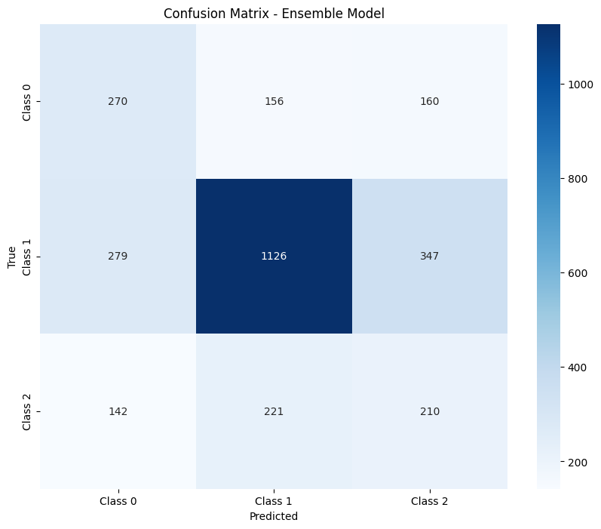
Confusion Matrix
Key Insights:
Class 0 (Majority):
Low recall (27%) → Misclassified as Class 1 (156) and Class 2 (160).
Class 1:
Overpredicted (1126 vs. 800 actual) → Bias inflates accuracy.
Class 2 (Minority):
Worst recall (35%) → Errors in Class 1 (221) and Class 0 (142).
Overall:
67% accuracy (Class 1-driven) | Severe minority-class underperformance.

Slide 29
Ensemble Model Performance
Why Did the Ensemble Underperform?
Complementary Weaknesses: Combined models shared similar biases toward the majority class.
Minority Class Challenges:
Ensemble failed to resolve linguistic nuance gaps (e.g., sarcasm, context).
SMOTE oversampling insufficient for hate speech patterns.
Accuracy-F1 Trade-off: Majority voting favored majority-class accuracy over minority-class balance.

Slide 30
Recommendations
Use BERT/RoBERTa to detect multilingual hate speech (Swahili, Sheng).
Add diverse hate examples to improve training data.
Combine SMOTE + cost-sensitive learning to fix class imbalance.
Focus moderation during high-activity months like July.
Use rule-based filters (e.g., 'Ruto must go') for early flagging.

Slide 31
Conclusion
Class imbalance (38% hate) limits detection accuracy.
Hate tweets show lowest engagement — underdetected.
Common phrases reflect political unrest and protest.
Transformers and better data needed for fairness.
Goal: Fair moderation across all political speech.

Slide 32
Thank you

